Slide 1
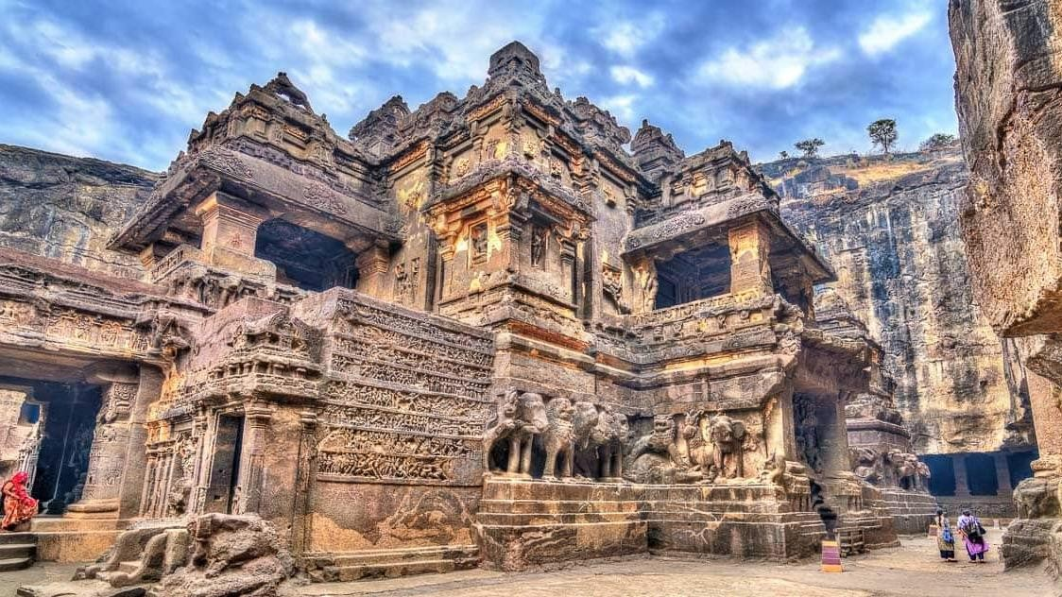
Investible Projects and Public Private Partnerships
Government of Maharashtra
March 2023

Slide 2
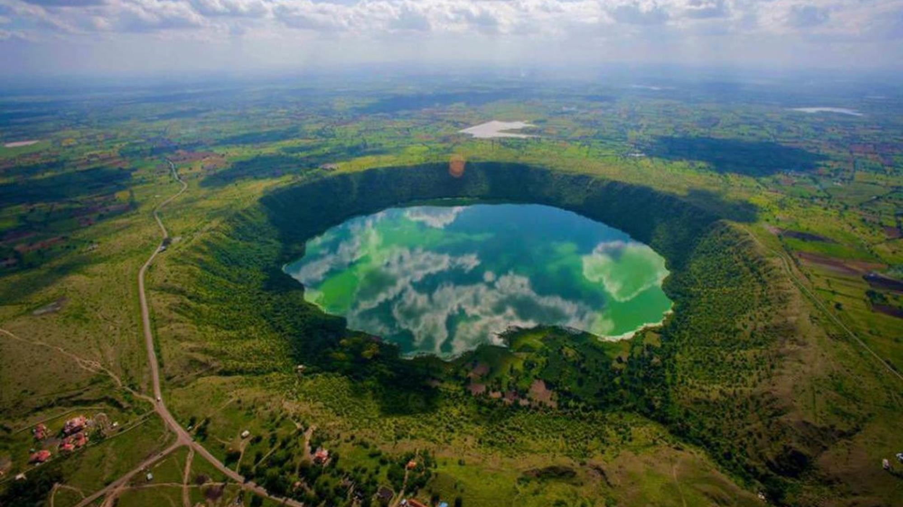
नमस्कार
Agenda
01 | Maharashtra Policy context
02 | Investible opportunities
03 | Institutional arrangement
04 | Best practices
05 | Case studies

Slide 3
Maharashtra Tourism Policy 2016
Y-o-Y sector growth of 10%
from 5.5% at present
Increase in sector share to 15% in GDP
from 9.5% at
present
Create one million additional jobs in the sector by 2025
Generate fresh investments to the tune of INR 30,000 Cr by
2025
Higher level of private sector participation
1 2 3 4 5
Translating policy intent and targets into reality through strategic and focused planning and implementation

Slide 4
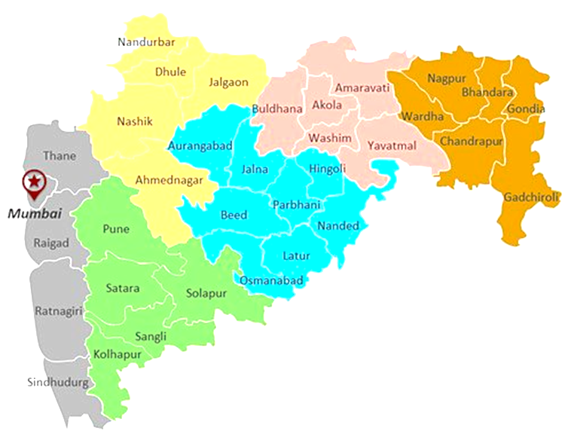
Investible opportunities
Lonar
Gosikhurd
Ajanta
Erangal
Ajispur
Gorai
Matheran
Tadoba
Mahabaleshwar
Greenfield Property Locations
4 coastal locations
1 Near World heritage site
1 Near Tiger reserve
2 near Lonar Crater
1 Dam-Aqua Sports
1 Fort
Raigad
Neoshi
Mithbav

Slide 5
Investment opportunities
Sr. No. | Location | Area available (H.a.) | Projected Plan | Specialty of location
1. | Ajanta, Dist. Aurangabad | 254 | Star category/ budget hotel , resort, theme park, convention centre | Adjacent to World Heritage site ajanta caves
2. | Mithbav, Dist. Sindhudurg | 40 | Star category beach resort, wellness centre. | Pristine beach virgin location
3. | Gorai beach Mumbai suburban | 50 | Budget hotel, eco resort, theme park adventure /water park, shooting location | Adjacent to Mumbai, the economic hub of India
4. | Erangal beach Mumbai suburban | 14 | Eco resort, kalagram ,shooting location | Adjacent to Mumbai, the economic hub of India
5. | Tadoba, Dist. Chandrapur | 25 | Star category eco- jungle resort | Adjacent to Tadoba Tiger reserve.

Slide 6
Investment opportunities
Sr. No. | Location | Area available (H.a.) | Projected Plan | Specialty of location
6. | Lonar, Dist. Buldhana | 20 | Eco- Resort | Adjacent to World famous Lonar crater.
7. | Gosikhurd, Dist. Bhandara | 20 | Boat Club & Eco Resort | Huge water body connects 3 district
8. | Pachad, Dist. Raigad | 15 | Tent City, Eco-resort | At the foothills of Raigad Fort
9. | Nevoshi, Dist. Ratnagiri | 40 | Star category resort, Amusement Park , Golf Corse | Beach nearby virgin location
10. | Ajispur (Lonar), Dist. Buldhana | 10 | Eco resort, agro tourism project | Adjacent to World famous Lonar crater.

Slide 7
Investment opportunities – Aquatic Tourism
Ocean & Coast
Rivers & Reservoirs
Land Development
MTDC Resorts
Cruise Tourism
Island Tourism
Submarine Tourism
Theme Parks
Whale Safari
Scuba Diving
Ocean Cruising
House Boat Tourism
Water Sports
HOHO Boats
Beach Shacks
Resorts, Café/Bars
River Cruising
House Boat Tourism
Water Sports
Island Tourism
Café/Bars
Resorts, Café/Bars
Luxury Tents
Sea Planes
Resorts
Luxury Tents
Restaurants
Café/Bars
Wellness Centres
Theme Parks
Amusement Park
MICE Tourism
Caravan Parks
Adventure Tourism
Way Side Amenities
Resorts
Luxury Tents
Restaurants
Café/Bars
Wellness Centres
Theme Parks
Amusement Park
MICE Tourism

Slide 8
Investment opportunities – Aquatic Tourism
Gosikhurd
Submarine Tourism
Beach Shack
MTDC Land Bank
Resorts
Luxury Tents
Restaurants
Café/Bars
Wellness Centres
Theme Parks
Amusement Park
MICE Tourism

Slide 9
Institutional arrangement
Tourism Investment Facilitation Cell (TFIC)
Key roles and responsibilities-
Identification of investors and shortlisting investment projects
Continuous interaction and handholding investors
Monitoring and trouble shooting
Transaction advisory and closing the transaction
Dedicated Investment facilitation officer

Slide 10
Best practices
Incentives for private sector
Single window clearance
Development of infrastructure
Online registration
Upfront Capital incentives and reimbursements in the form of SGST and electricity duty
Developing support infrastructure through RTDS and private funding
One stop online registration for hotels and other tourism facilities
Provide Single window clearance for PPP Projects

Slide 11
Case studies of PPP transactions
Property Selection
Greenfield Development Rationale -
To get anchor private players to enter less developed tourism destinations with high potential to catalyze development in the region
To generate funds for large ticket capex projects from the private sector
Brownfield Development Rationale –
To get private players to invest in old properties requiring significant upgradation and bring it up to best-in-class benchmarks
To improve operational efficiency of prominent but underperforming resorts by applying industry best practices
Process Adopted
Appointed transaction advisor
Organized a pre-tender roadshow to mobilize interest
Undertook extensive stakeholder consultation to ensure bidder considerations are understood
Undertook extensive PR during the tender process to market the opportunity
Opportunity Structuring
Adopted a license model instead of a lease model to avoid creation of encumbrances on underlying land and property
Balanced risk-reward sharing with hybrid revenue model to secure minimum license fee for MTDC and leaving some room for revenue share linked to performance
Kept bid structure simple and easy to follow for the bidder and easy for MTDC from compliance perspective
30+30 year license period with Right of First Refusal
RFP structure was Qualification + H1
Funds Mobilized
Process took over 2 years from conceptualization to materialization
Potential to mobilize ~Rs 1,000 Cr through funds towards project cost and license fee over the period of the license
11

Slide 12
Case studies from lease renewal transactions
Property Selection
Small resorts and properties at popular locations in Maharashtra which were given on 30+30 years lease for which the first 30 years had expired
Properties at popular locations across Maharashtra
Renewal clause in the contract mentioned that lease rental will be revised basis prevailing market rates at the time of renewal
Process Adopted
Appointed transaction advisor
Extensive benchmarking exercise was undertaken to arrive at prevailing market rates
Contractual compliance was checked over the initial 30-year period to identify if there were any major lapses in compliance
Those properties with major lapses are being sent notices for termination and new tender process is to be initiated to fresh price discovery
Those with minor lapses are being offered prevailing market rates as per benchmarking, and if accepted the contract will be renewed, else it will be terminated and new tender process is to be initiated to fresh price discovery
Funds Mobilized
Potential to mobilize ~Rs 600 Cr through funds towards project cost and lease rental over the period of the lease
Process took over a year from temporary extension given till determination of prevailing market rates for offer to the lessees

Slide 13
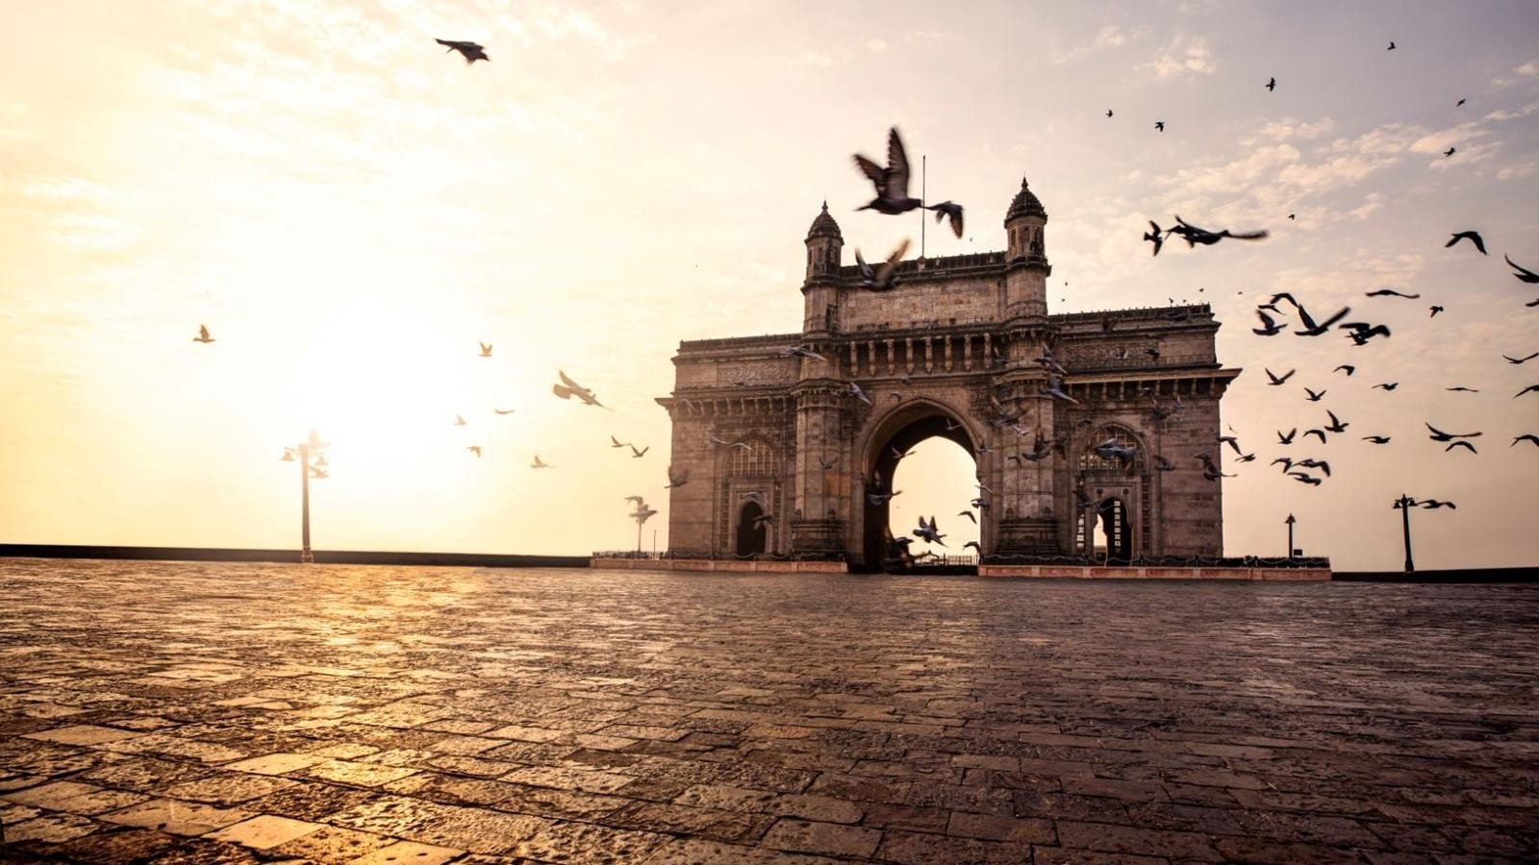
Thank You
Page 64 20 January 2023 Appointment of Consultant for advisory support to Dept of Tourism, Govt of Maharashtra

